Slide 1
Question Set 1 – Question 1 (Query No. 1 in the text file)
We want to understand more about the movies that families are watching. The following categories are considered family movies: Animation, Children, Classics, Comedy, Family and Music.
This information is not particularly dispersed. A total spread of 16 (67-51) does not persuade me that families favor one category over the other, despite the fact that it is obvious that the "Family" category is in the lead. Even the lowest rented genre (Music) was rented more than 50 times, suggesting that families may not have a significant preference for "Family" and "Animation" films.

Slide 2
Question Set 2 – Question 1 (Query No. 2 in the text file)
We want to find out how the two stores compare in their count of rental orders during every month for all the years we have data for.
Generally speaking, it seems that as summer approaches (peaking in July), rental orders gradually rise, and as winter approaches, rental orders gradually fall. It's difficult to be certain without data for the missing months (1,3,4 9,10, 11,12). What I can tell with certainty is that for each month, the number of rental orders for store 1 compared to store 2 is essentially the same.

Slide 3
Question Set 2 – Question 2 (Query No. 3 in the text file)
We would like to know who were our top 10 paying customers, how many payments they made on a monthly basis during 2007, and what was the amount of the monthly payments.
This graph shows the number of payments made each month as bars with numbers listed on the primary axis (the left Y-Axis). The amount paid each month is represented by a line, the values of which are displayed on the secondary axis (the Y-axis on the right). I attempted to add data labels to each bar and line, but it just looked a mess.

Slide 4
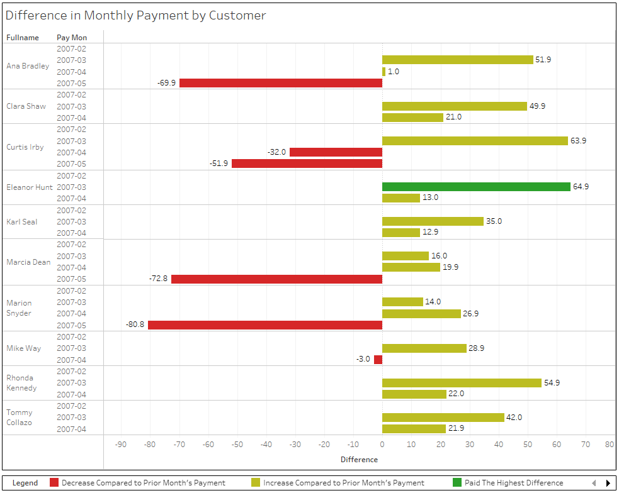
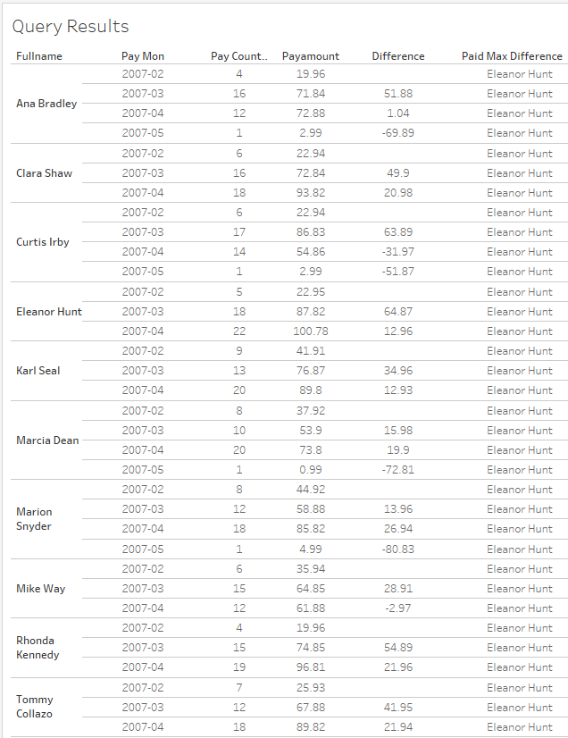
Question Set 2 – Question 3 (Query No. 4 in the text file)
For each of these top 10 paying customers, I would like to find out the difference across their monthly payments during 2007. Repeat this for each of these 10 paying customers. Also, it will be tremendously helpful if you can identify the customer's name who paid the most difference in terms of payments.
I wasn't sure how to portray this, but I attempted to picture the variation in monthly payments as values on either side of zero. Positive differences in payment are on the right side of zero in the mustard color, whereas negative differences are on the left side of zero in red. The highest differential payer is shown in green. This person is also indicated in the "paid max difference column" of the query results. I had trouble creating this chart in Excel, so I did it in Tableau.

